Slide 1
The Battle of Neighborhoods
Amey Deshpande
March-2020

Slide 2
Motivation
The purpose of this Project is to help people in exploring better facilities around their neighborhood. It will help people making smart and efficient decision on selecting great neighborhood out of numbers of other neighborhoods in Scarborough, Toronto.
Lots of people are migrating to various states of Canada and needed lots of research for good housing prices and Better schools for their children. This project is for those people who are looking for better neighborhoods. For ease of accessing to Cafe, School, Super market, medical shops, grocery shops, mall, theatre, hospital, like minded people, etc.
This Project aim to create an analysis of features for a people migrating to Scarborough to search a best neighborhood as a comparative analysis between neighborhoods. The features include median housing price and better school according to ratings, crime rates of that particular area, road connectivity, weather conditions, good management for emergency, water resources both fresh and waste water and excrement conveyed in sewers and recreational facilities.
It will help people to get awareness of the area and neighborhood before moving to a new city, state, country or place for their work or to start a new fresh life.

Slide 3
Objective
Applying k-mean clustering algorithm to cluster the neighborhood based on their similarities in different amenities and venues.
For defining success we will try to figure out the optimal cluster size by doing some exploratory data analysis on different clusters and trying to observe their similarities.

Slide 4
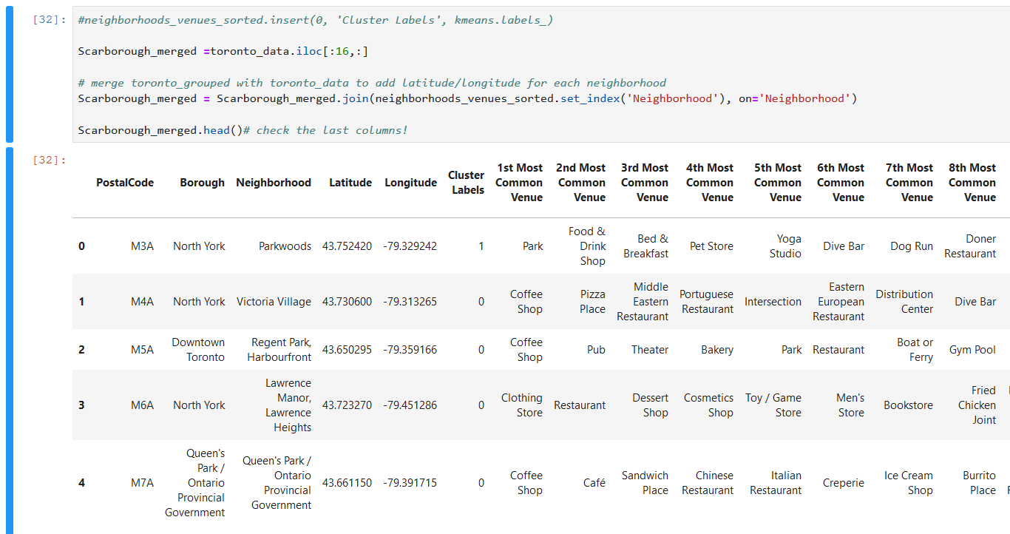
K Mean Clustering Approach

Slide 5
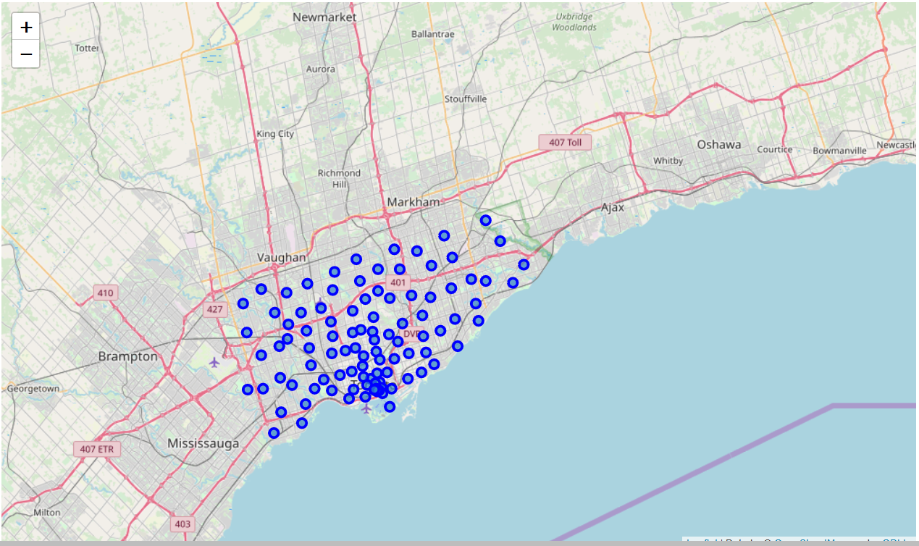
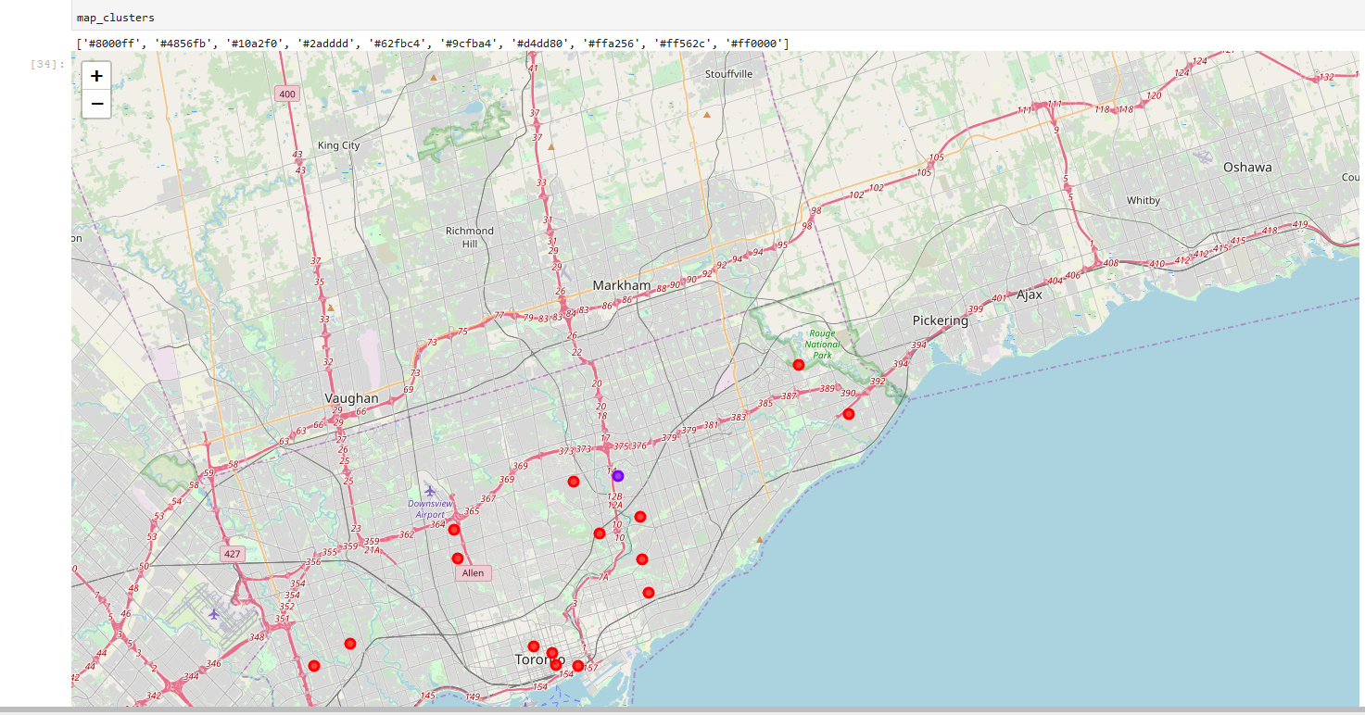
Cluster Visualization - Toronto Zip codes with the assigned cluster label
Before Clustering
After Clustering

Slide 6
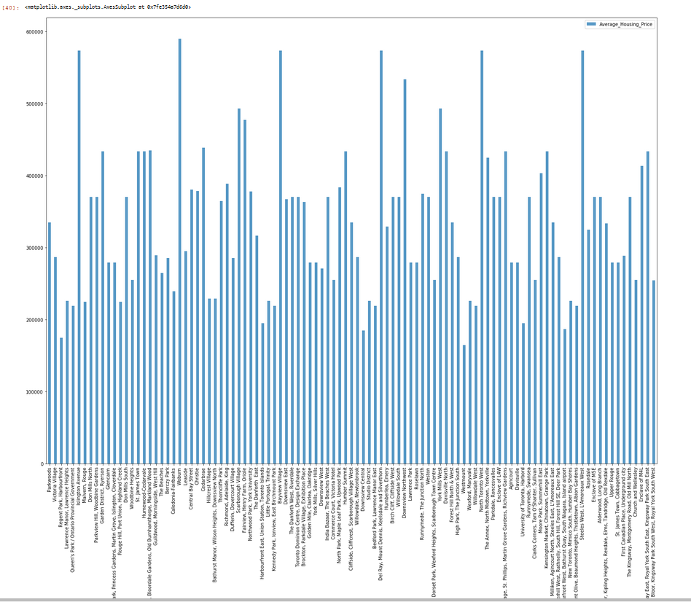
Average Housing Price by Clusters in Scarborough

Slide 7
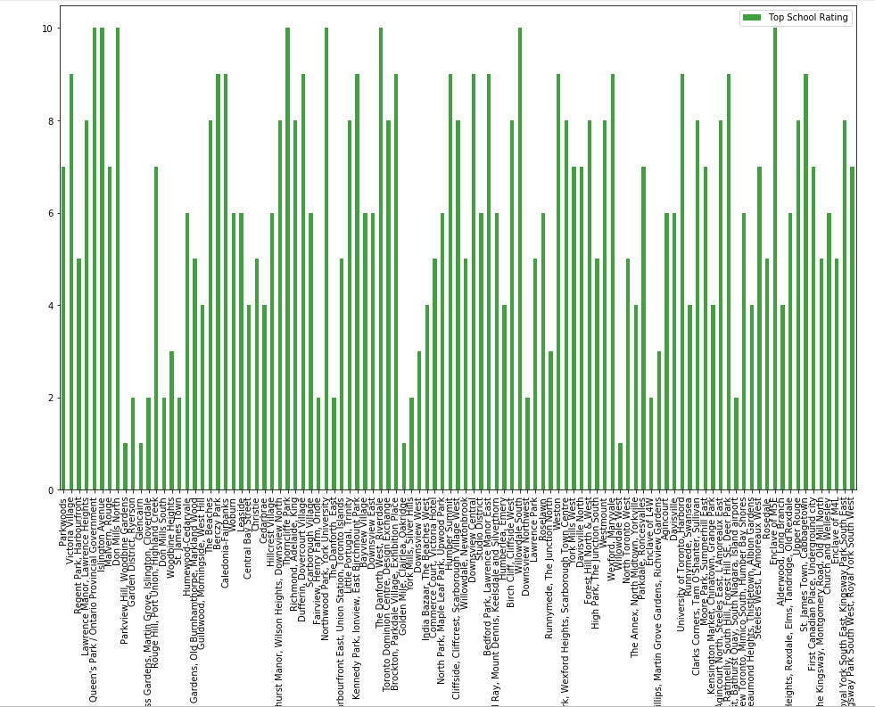
School Ratings by Clusters in Scarborough

Slide 8
Conclusion
Scarborough is a popular destination for new immigrants in Canada to reside. As a result, it is one of the most diverse and multicultural areas in the Greater Toronto Area, being home to various religious groups and places of worship. Although immigration has become a hot topic over the past few years with more governments seeking more restrictions on immigrants and refugees, the general trend of immigration into Canada has been one of on the rise.

Slide 9
Thank You

